Slide 1


Hands on Workshop

Slide 2
Introduction to Robotics
1
3
2
4
Contemporary Robots
Basic Component of Robots
Role of Engineers in robotics
Types of Robots

Slide 3
Components of Robots
Sensors (Eyes, Ears, Nose)
Controller (Brain)
Actuators (Legs, Hands)

Slide 4
Microcontroller
It is designed to perform specific Applications
It has got fixed amount of RAM, ROM and other peripheral components on a single chip
Applications: Keyboards, Mouse, Washing machine, Digicam etc

Slide 5
1
Arduino

Slide 6
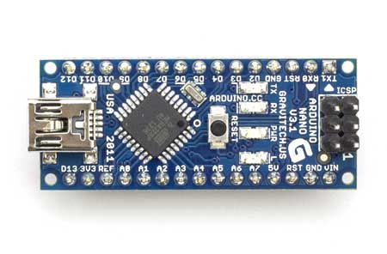
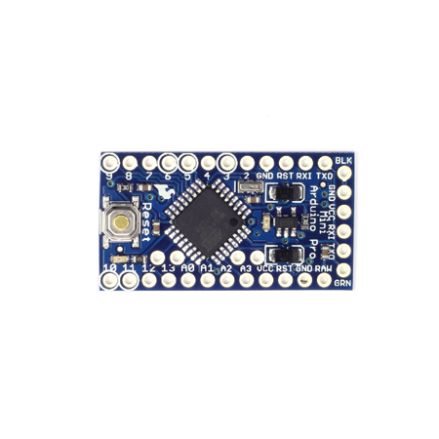
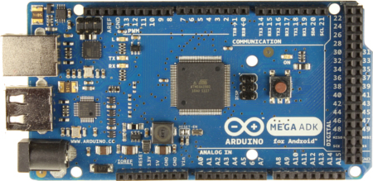
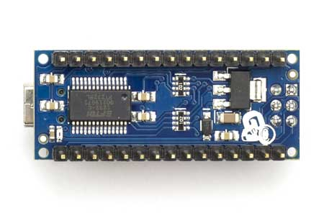
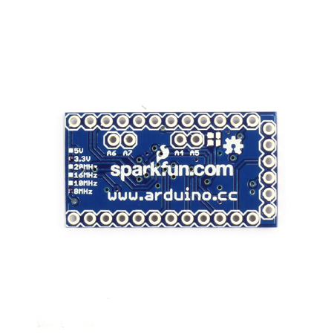
Arduino Boards
Arduino Nano
Arduino Mini
Arduino Mega

Slide 7
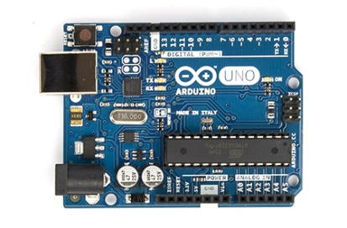
Arduino UNO

Slide 8
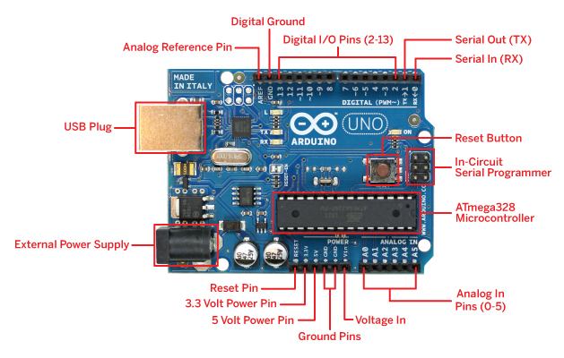
Arduino Components
Microcontroller ATmega328
Operating Voltage 5V
Input Voltage (recommended)7-12V
Digital I/O Pins 14
(of which 6 provide PWM output)
Analog Input Pins 6
DC Current per I/O Pin 40 mA
DC Current for 3.3V Pin 50 mA

Slide 9
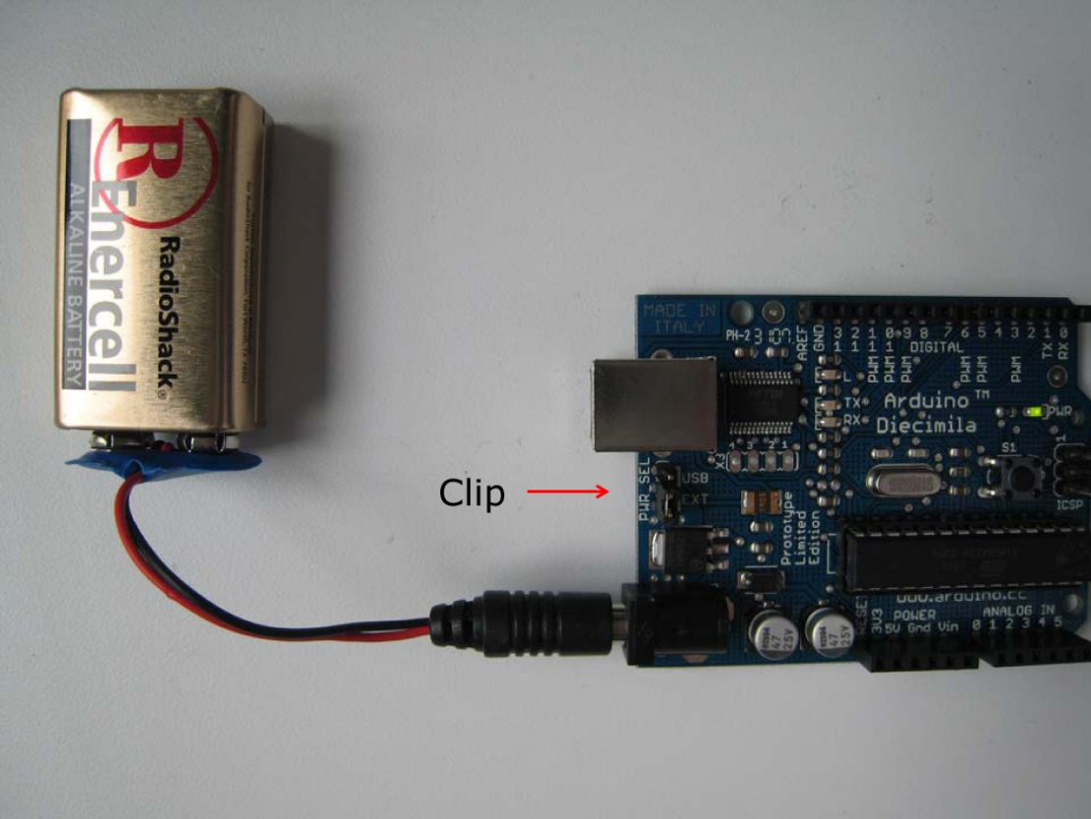
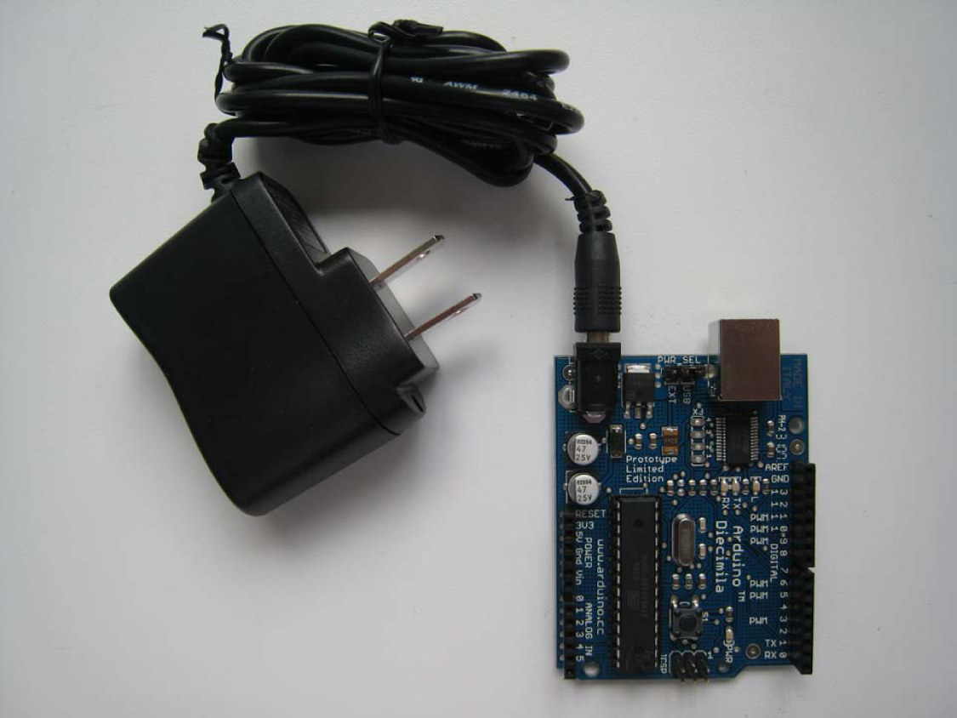
Power Supply

Slide 10
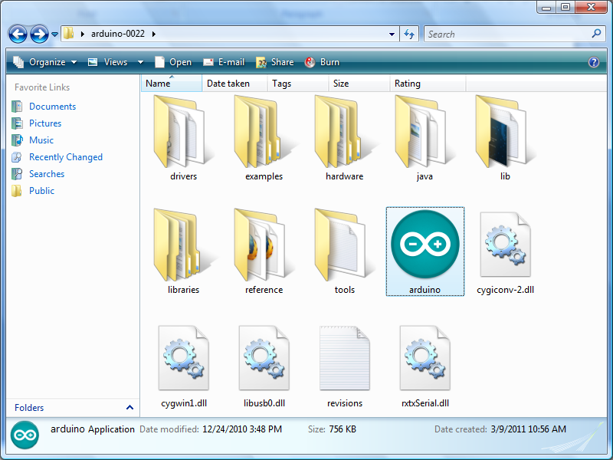

Arduino Software
Download Software
unzip the folder.
launch the programming environment.
install a driver that comes with Arduino - communication
http://arduino.cc/en/Main/Software

Slide 11
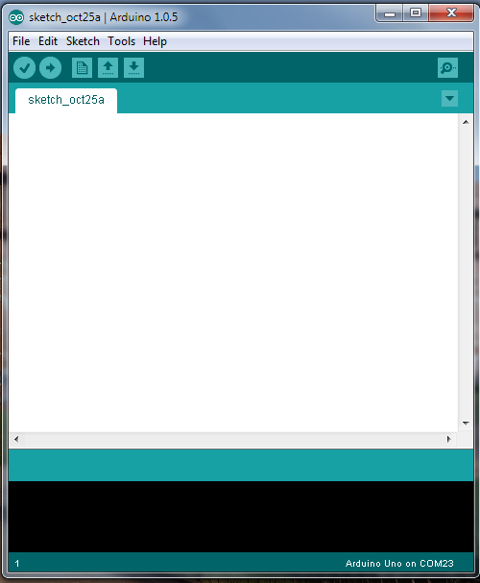
Compile
(verify)
Upload
Actual Code
(Editor)
Message Box

Slide 12
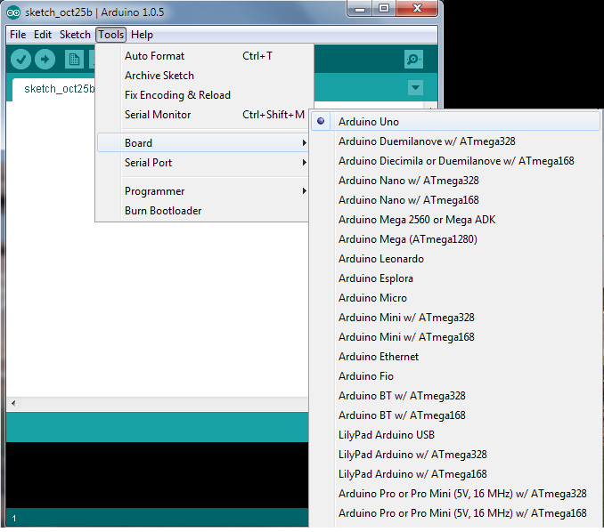
Configuring IED
Actual Code
(Editor)

Slide 13
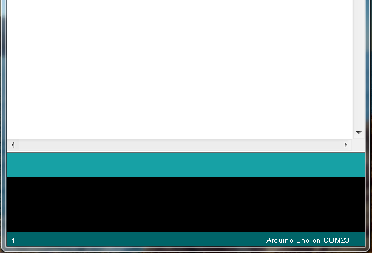
Board Name
&
Port No.

Slide 14
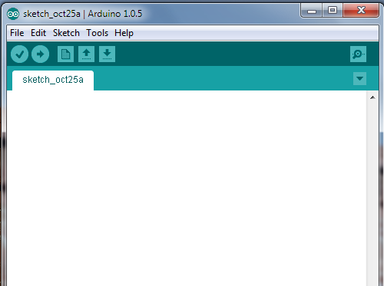
Serial Monitor
Serial Monitor
Actual Code
(Editor)

Slide 15
PWM (Pulse Width Modulation) Control
Used to control motor speed
6 PWM pins (3,5,6,9,10,11), can also be used as Digital IO
Values vary from 0-255
For speed control:
5V Potential - Analog Value 225/ Digital Value 1 = Full Speed of 150RPM
0V Potential - Analog Value 0 / Digital Value 0 = Zero Speed
Analog Value = Duty cycle * 255
Where,
% duty cycle = % speed

Slide 16
Instructions
pinMode( pin number, state );
state- INPUT/OUTPUT pin number- pin you are using
digitalWrite( pin number , state ); state- HIGH/LOW
digitalRead( pin number);
analogRead( pin number);
pin number- 3,5,6,9,10,11 analog value- 0 to 255 (depends on speed)

Slide 17
Conditions & Loop
While (condition) {………}
If ( condition ) {……..} else if (condition) {……..} else (condition) {……….}

Slide 18
Arduino Programing
Two mandatory functions:
1. void setup()
{
// the setup routine runs once when you press reset or when you powered it ON.
}
2. void loop()
{
// the loop routine runs continuously
}

Slide 19
PROGRAM TO GLOW AN LED
pinMode:
Syntax:
pinMode(<pin no.>,<mode>);
pin no. : 0 – 13
mode : OUTPUT / INPUT
digitalWrite:
Syntax:
digitalWrite(<pin no.>,<State>);
pin no. : 0 -13
State : HIGH / LOW or ON/OFF
void setup()
{
pinMode(13,OUTPUT);
}
void loop()
{
digitalWrite(13,HIGH);
}

Slide 20
PROGRAM TO BLINK AN LED
int led = 13;
// the setup routine runs once when you press reset
void setup() {
// initialize the digital pin as an output.
pinMode(led, OUTPUT);
}
// the loop routine runs over and over again forever:
void loop() {
digitalWrite(led, HIGH); // turn the LED on (HIGH is the voltage level)
delay(1000); // wait for a second
digitalWrite(led, LOW); // turn the LED off by making the voltage LOW
delay(1000); // wait for a second
}

Slide 21
2
Building the Robot

Slide 22
ASSEMBLING

Slide 23
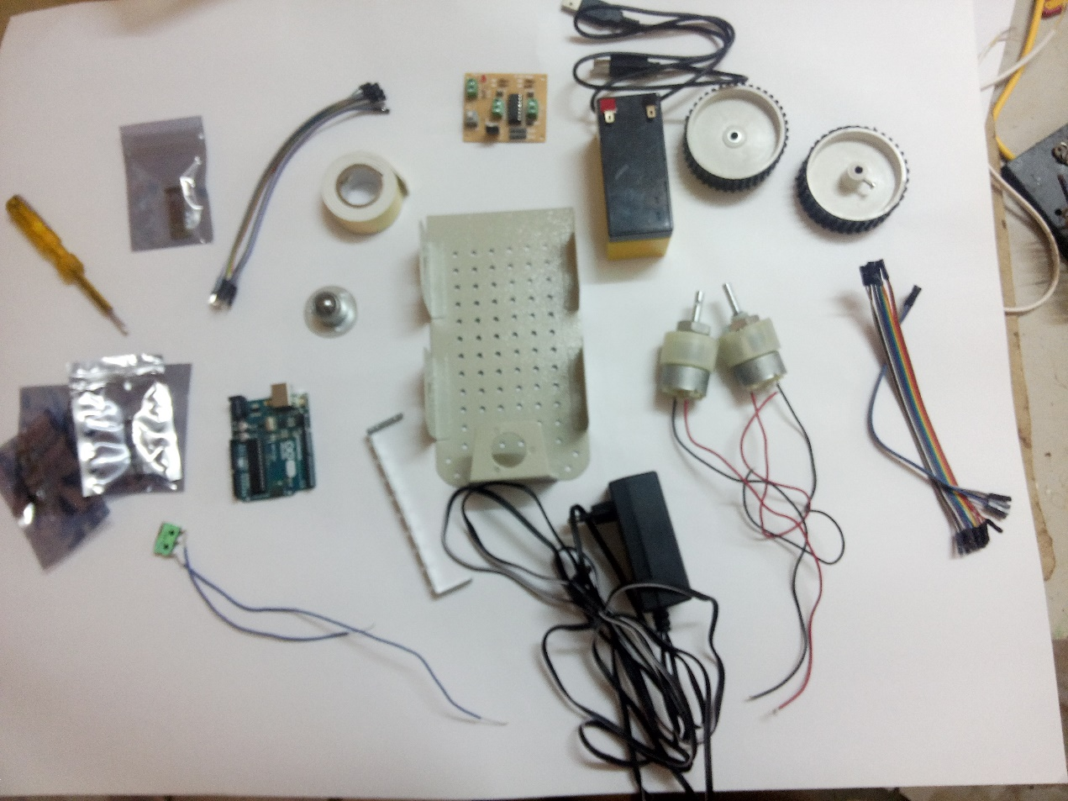
Components Provided
SI No | Components
1 | Robot chasis
2 | Castor Wheel
3 | H-Bridge
4 | 150 rpm motors
5 | F-F wires
6 | M-F burg wires
7 | Bluetooth module
8 | IR sensor
9 | Micro switch
10 | Lead acid battery
11 | Wheels
12 | L293D IC
13 | Battery chips
14 | Arduino board
15 | Screw & nuts
16 | Screw driver

Slide 24
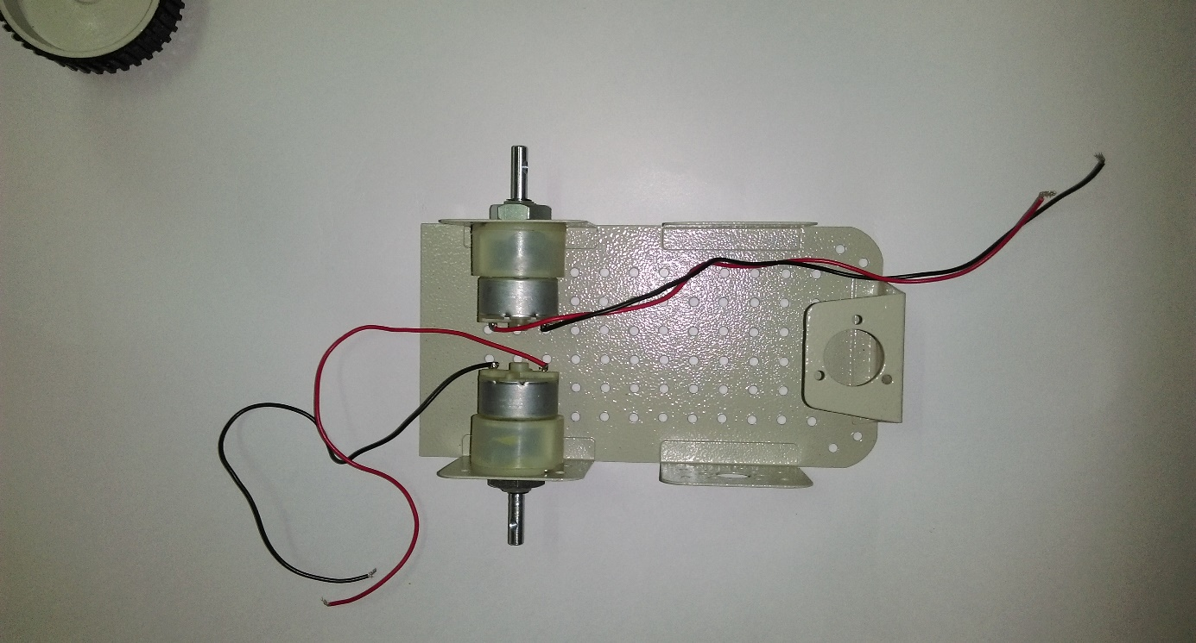
Step 1 – Attach Motors to chasis

Slide 25
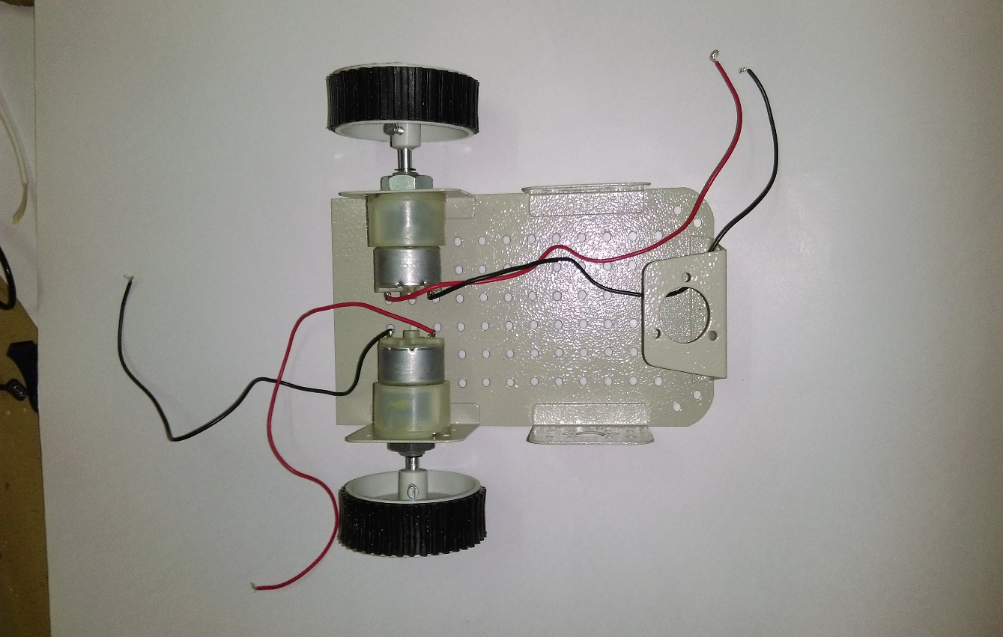
Step 2 – Attach Wheels

Slide 26
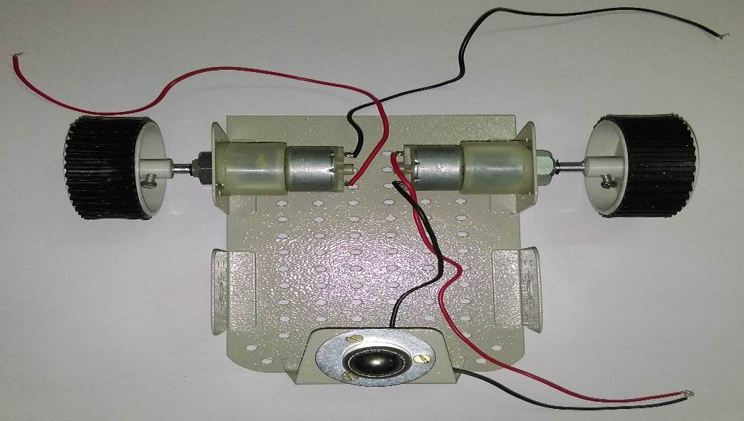
Step 3 – Fix castor wheel

Slide 27
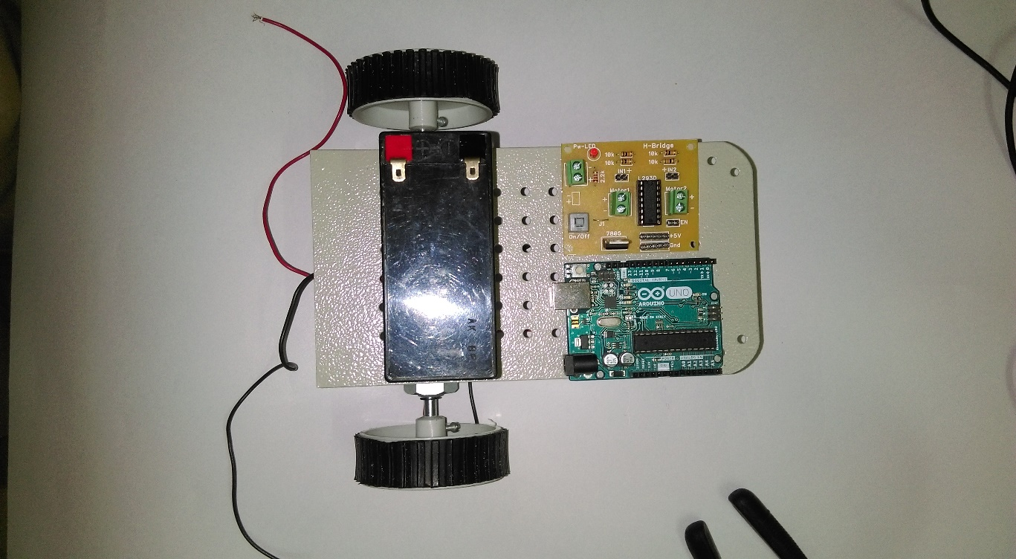
Step 4 – Attach Battery, H bridge, Arduino

Slide 28
Do’s & Don’t
Don’t connect the battery directly to the Arduino board.
Pay attention in handling the batteries
Don’t Reverse the terminal
Red – (+)ve; Black – (-)ve.

Slide 29
Motors
Motor – Types
Motor driver
Differential drive

Slide 30
Motors
Stepper Motor
Servo Motor
Brushless DC
DC Motor

Slide 31
3
Differential Drive

Slide 32
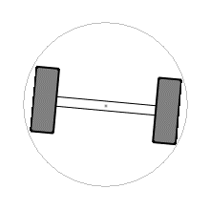
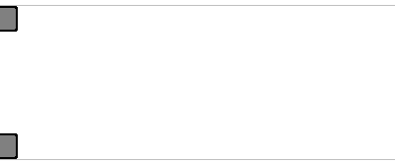
Moving Straight
To Spin

Slide 33
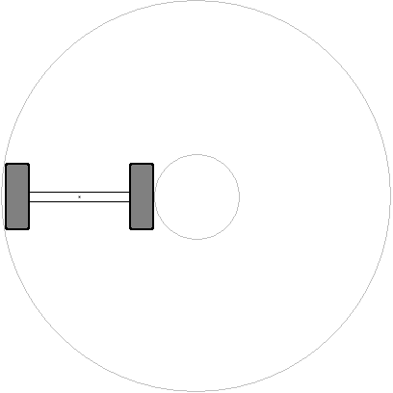
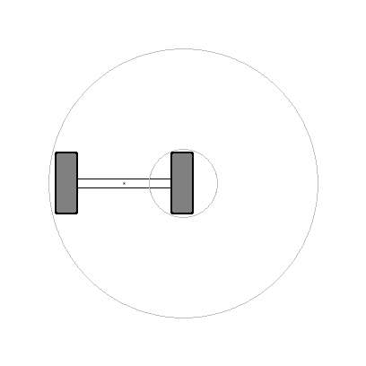
Longer Turn
Shorter Turn
Moving Straight
To Spin
33

Slide 34
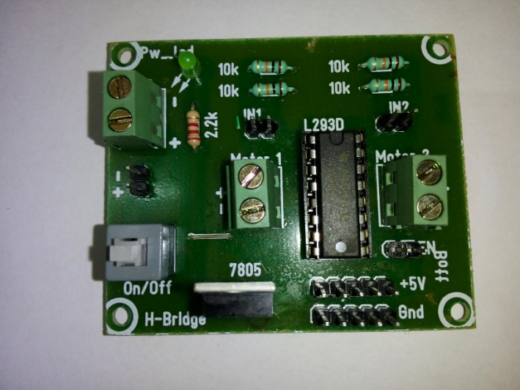
H-Bridge

Slide 35
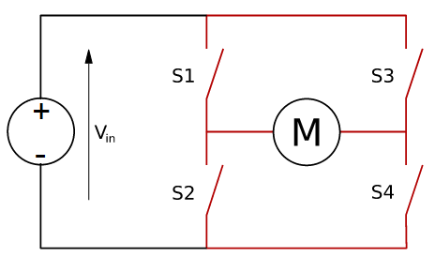
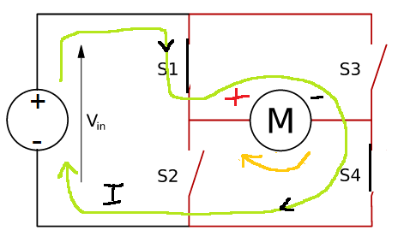
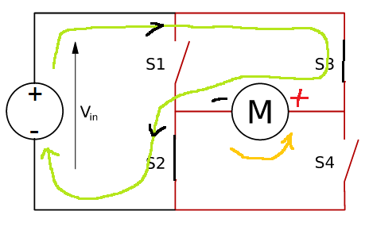

Slide 36
Program to Drive a Motor
// declarations of pins
int r_in1_a = 2,r_in1_b = 3;
void setup() {
// initialize the digital pin as an output.
pinMode(r_in1_a, OUTPUT);
pinMode(r_in1_b, OUTPUT);
}
void loop()
{
digitalWrite(r_in1_a, HIGH);
digitalWrite(r_in1_b, LOW);
}

Slide 37
// declarations of pins
int r_in1 = 2,r_in2 = 3;
int l_in1 = 4,l_in2 = 5;
void setup() {
// initialize the digital pin as an output.
pinMode(r_in1, OUTPUT);
pinMode(r_in2, OUTPUT);
pinMode(l_in1, OUTPUT);
pinMode(l_in2, OUTPUT);
}
void loop()
{
digitalWrite(r_in1, HIGH);
digitalWrite(r_in2, LOW);
digitalWrite(l_in1, HIGH);
digitalWrite(l_in2, LOW);
}

Slide 38
Try These
Both motors – Forward.
Both motors – Backward.
Turn Left
Turn Right
Spin the robot

Slide 39
Speed Control
PWM – Speed control
6 PWM Pins (3,5,6,9,10,11)
Values vary from 0-255
For speed control:
5V Potential - Analog Value 225/ Digital Value 1 = Full Speed of 150 RPM
0V Potential - Analog Value 0 / Digital Value 0 = Zero Speed

Slide 40
Program to control the speed
// declarations of pins
int r_in1 = 3,r_in2 = 5;
void setup() {
// initialize the digital pin as an output.
pinMode(r_in1, OUTPUT);
pinMode(r_in2, OUTPUT);
}
void loop()
{
analogWrite(r_in1, <0-255>);
analogWrite(r_in2, <0-255>);
}
pinMode(<PWM pin>, OUTPUT);
void loop()
{
analogWrite(<pin no.>,<value>);
}

Slide 41
4
Sensing the environment

Slide 42
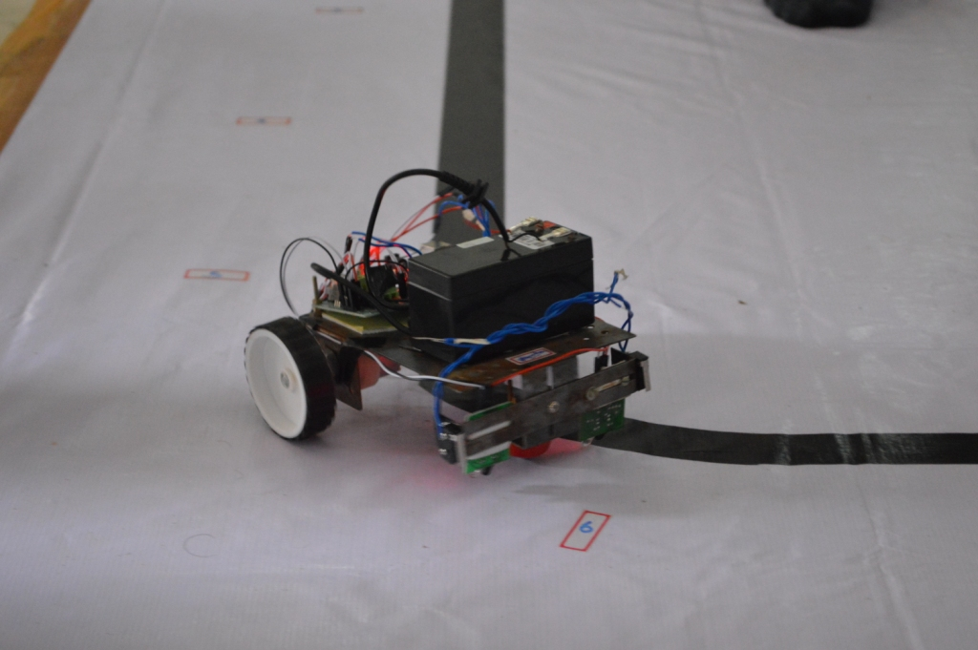
Line Follower
Sense the presence of line
Sensor – IR sensor

Slide 43
IR Waves
IR –Infrared waves
They are part of the Electromagnetic Radiation
Range:700nm to 1mm
Applications: Remote sensors, CCTV cameras, Thermal Imaging and Astronomy

Slide 44
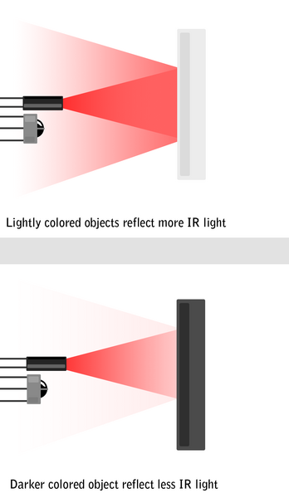
White – Transmitter
Black – Receiver
Surface | Sensor Output
Black | 5v(HIGH)
White | 0v(LOW)
Light Colored objects reflects the
Light (More Reflection)
Dark colored object absorbs
the light (Less Reflection)

Slide 45
Line Follower Logic
If Sensor detects Black Line
True
Move left for 500ms
False
Move Right

Slide 46
// declarations of pins
int sen1=4,sen2=5;
int state1,state2;
void setup()
{
// initialize the digital pins as an input.
pinMode(sen1, INPUT);
pinMode(sen2, INPUT);
}
void loop()
{
state1 = digitalRead(sen1);
state2 = digitalRead(sen2)
}
Sen1 (Left) | Sen2 (Right) | Action
Low | Low | Go Straight
Low | High | Turn Right
High | Low | Turn Left

Slide 47
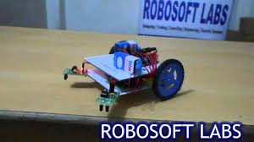
Edge Detection
Sense the absence of path
Sensor – IR sensor

Slide 48
Line Follower Logic
If Sensor detects empty space
True
Move left for 500ms
False
Move Right

Slide 49
// declarations of pins
int sen1=4,sen2=5;
int state1,state2;
void setup()
{
// initialize the digital pins as an input.
pinMode(sen1, INPUT);
pinMode(sen2, INPUT);
}
void loop()
{
state1 = digitalRead(sen1);
state2 = digitalRead(sen2)
}
Sen1 (Left) | Sen2 (Right) | Action
High | High | Go Straight
Low | High | Turn Right
High | Low | Turn Left
Low | Low | Turn Left

Slide 50
Any Questions

Slide 51
Thanks You!

